Slide 1
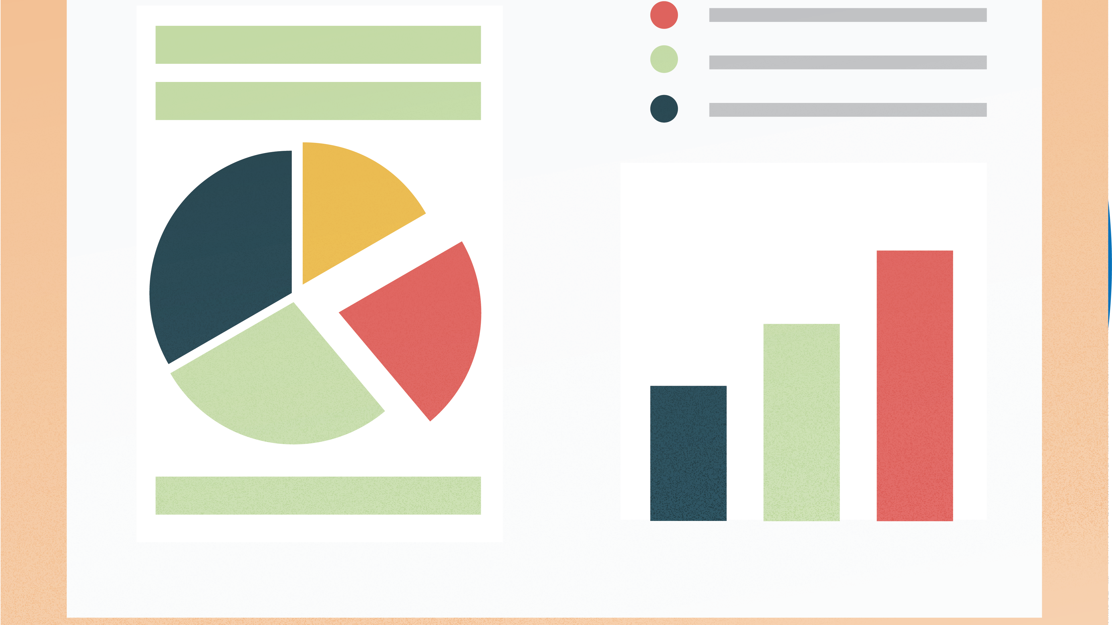
Statistics – Data Analyst
Fundamental Concepts
Mean
Variance
Standard Deviation
Next Steps
To do
27/03/25

Slide 2
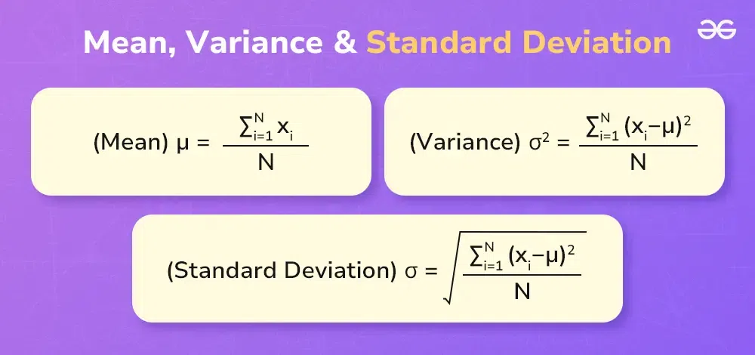
Fundamental Concepts
Mean, Variance and Standard Deviation
Fundamental concepts in statistics and engineering mathematics, essential for analyzing and interpreting data. These measures provide insights into data’s central tendency, dispersion, and spread, which are crucial for making informed decisions in various engineering fields

Slide 3
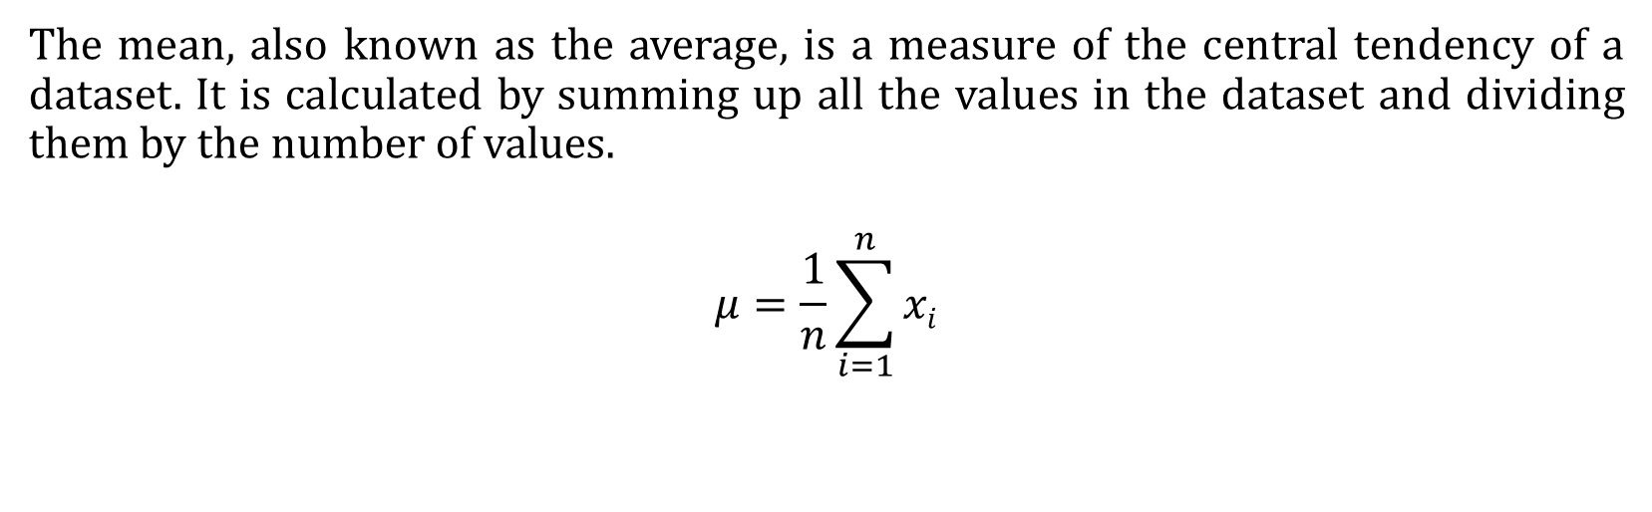
Mean
The mean, also known as the average, is a measure of the central tendency of a dataset. It is calculated by summing up all the values in the dataset and dividing them by the number of values.
$$μ=\frac{1}{n}\sum_{i=1}^{n}{xi}$$

Slide 4
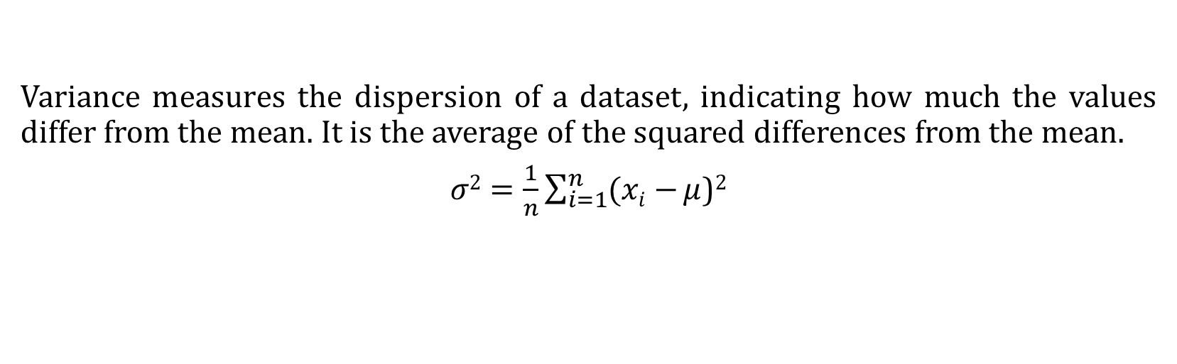
Variance
Variance measures the dispersion of a dataset, indicating how much the values differ from the mean. It is the average of the squared differences from the mean.
$σ2=\frac{1}{n}\sum_{i=1}^{n}{(xi−}μ$)²
average of the squared difference from the mean

Slide 5
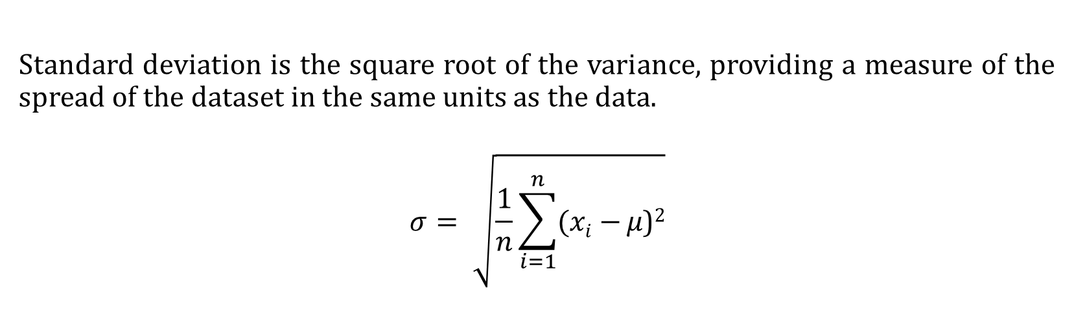
Standard Deviation
Standard deviation is the square root of the variance, providing a measure of the spread of the dataset in the same units as the data.
$$σ= \sqrt{\frac{1}{n}\sum_{i=1}^{n}{(xi−}μ\text{)}\text{2}}$$

Slide 6
Next Steps…
https://www.geeksforgeeks.org/mathematics-mean-variance-and-standard-deviation/#what-is-mean
Understanding ‘ Measures of dispersion’
Updating presentation with
Sample & Population
Actual Mean, Assumed Mean & Step-Deviation
Python project on the above
Add images

Slide 7
To do….
Chapter 5: Getting Started with pandas
Chapter 7: Data Cleaning and Preparation
Chapter 8: Data Wrangling: Join, Combine, and Reshape

